Slide 1


Optimal Vehicle Selection Tool | State Farm
By Arun, Cassidy, Jeff, Noah, and Vikas

Slide 2





CONTENT
Project Overview
Data
Analysis
Process
Flow
Profile
Formulation
Final
Takeaways

Slide 3

Project Overview

Slide 4

Overview
Utilizing analytical tools and methodology, create vehicle profiles for a car selection tool. Based on vehicle attributes and reviews, provide car options that align with customer's wants and needs.
Notes:
It’s estimated that the financial impact of irregularities on the daily operations of a single major U.S. domestic carrier may exceed $440 million per annum in lost revenue, crew overtime pay, and passenger hospitality costs.

Slide 5





Project Steps
Organize
Collect
Analyze
Formulate
Developed a fluid plan on how to execute the project for each step of the way
Researched and collected all the necessary data to fulfill our deliverables
Combined datasets to create a comprehensive sheet to find significant trends
Generated clusters that represent different profile groups based on attributes desired
Notes:
It’s estimated that the financial impact of irregularities on the daily operations of a single major U.S. domestic carrier may exceed $440 million per annum in lost revenue, crew overtime pay, and passenger hospitality costs.

Slide 6




Tools Utilized
Excel (Data sheets)
Python (Sentiment, Combining)
Orange3 (Clustering)
Oracle SQL (Vehicle Selection)
Notes:
It’s estimated that the financial impact of irregularities on the daily operations of a single major U.S. domestic carrier may exceed $440 million per annum in lost revenue, crew overtime pay, and passenger hospitality costs.

Slide 7

Data Analysis

Slide 8
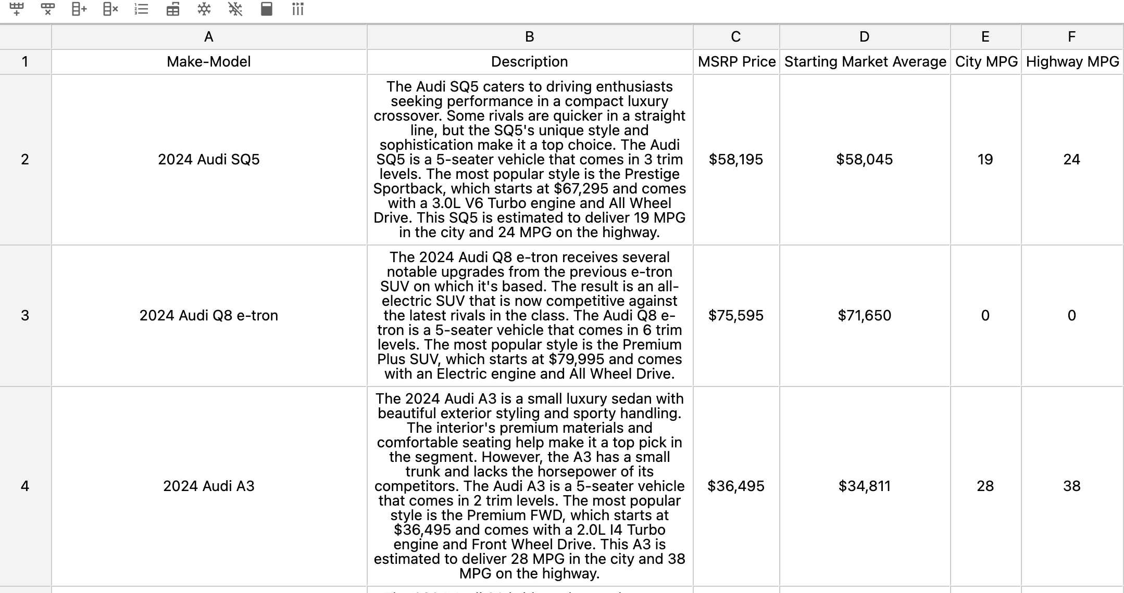
Describing our Data
Source: truecar.com
13 columns for attributes (MSRP, MPG, Wheel Drive, etc.)
20+ brands with over 250 models
Notes:
It’s estimated that the financial impact of irregularities on the daily operations of a single major U.S. domestic carrier may exceed $440 million per annum in lost revenue, crew overtime pay, and passenger hospitality costs.

Slide 9
Descriptive Stats
6 Numerical Variables
Variable | Mean | Median | Dispersion | Min | Max
MSRP | $51,134 | $43,095 | .53 | $17,075 | $159,995
Starting Market AVG. | $50,646 | $42,187 | .53 | $17,516 | $158,589
City MPG | 27.87 | 21 | 1 | 0 | 134
Highway MPG | 31.28 | 28 | .76 | 0 | 109
# of Seats | 5.18 | 5 | .26 | 2 | 15
Trim Levels | 4.4 | 4 | .65 | 1 | 18
Notes:
Brands and MSRPs

Slide 10
Descriptive Stats
5 Categorical Variables
Variable | Mode | Dispersion
Wheel Drive | All | 1.3
Engine Type | 2.0L | 2.7
Engine Turbo | Not Turbo | .81
Luxury | 0 (Not Luxury) | .54
Sport | 0 (Not sport) | .559
Notes:
Brands and MSRPs

Slide 11

Process Flow

Slide 12
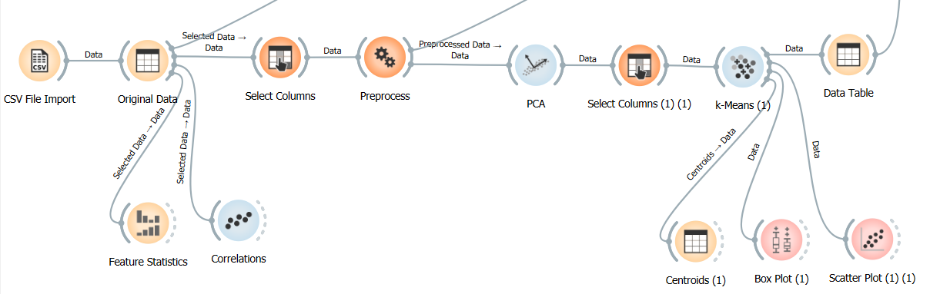
Orange – Data Science Tool
Orange is an open-source data visualization, machine learning and data mining toolkit. Wikipedia
Notes:
Add excel formulation snap – tech steps

Slide 13
Process Flow
01
02
03
04
05
Feature Selection
Data Pre-Processing
Applied ML Clustering
Cluster Definition
Profile Formulation
Notes:
It’s estimated that the financial impact of irregularities on the daily operations of a single major U.S. domestic carrier may exceed $440 million per annum in lost revenue, crew overtime pay, and passenger hospitality costs.

Slide 14
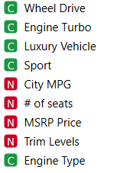
Feature Selection
Initial Features Selected (9)
Highly correlated** variables (strength of the relationship b/w two variables:
Highway MPG & City MPG = +0.978
Starting Market Average($) & MSRP($) = +0.997
These features were removed as they DO NOT have additional value/info for the model.
** Note: Pearson Correlation
Notes:
Add excel formulation snap – tech steps

Slide 15
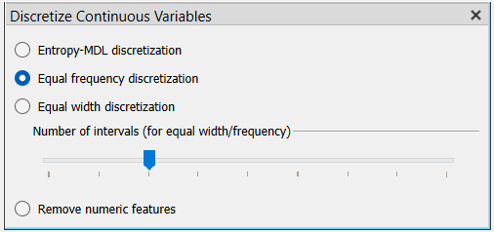
Data Pre-Processing
Principle Component Analysis (PCA)
No of Components: 2 (PC1 & PC2)
Explained Variance: 23%
Elbow Point Analysis
K-Means Clustering
No of Clusters: 4
Features Used: PC1 & PC2
Silhouette Score: 0.441
Notes:
The elbow point appears to be around the 2nd component. This is indicated by the change in the slope of the cumulative variance line (the thick line). Up to the 2nd component, the line rises steeply, indicating that each additional component explains a significant amount of variance.
After the 2nd component, the line becomes less steep, indicating that additional components explain less variance.
Therefore, the elbow point suggests that choosing the first two principal components may be a good balance between maximizing explained variance and minimizing the number of components. However, this is just a guideline and the optimal number of components can depend on other factors as well, such as the specific needs of your analysis.

Slide 16
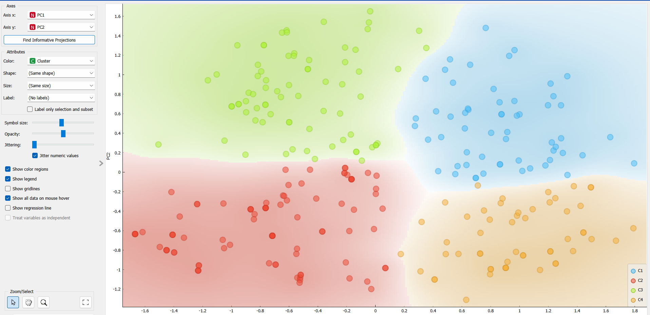
Applied ML - Clustering
Notes:
Add excel formulation snap – tech steps

Slide 17
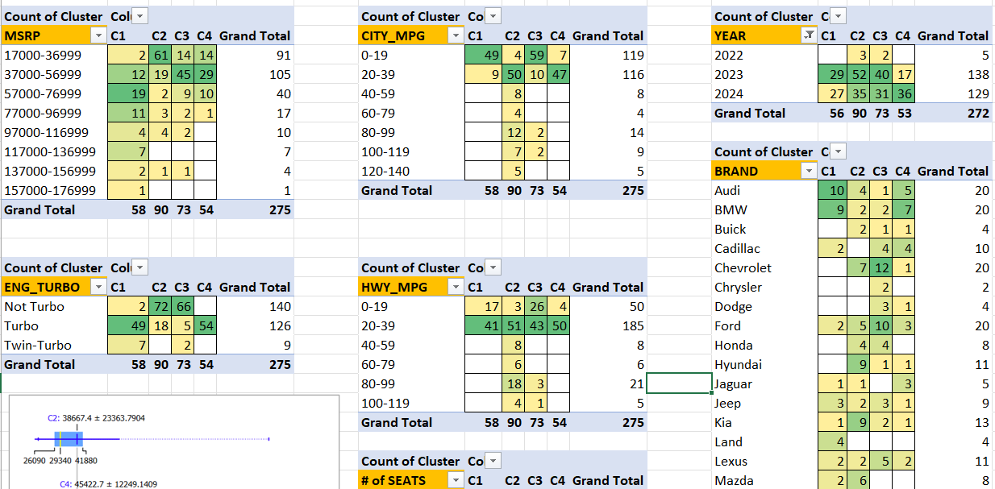
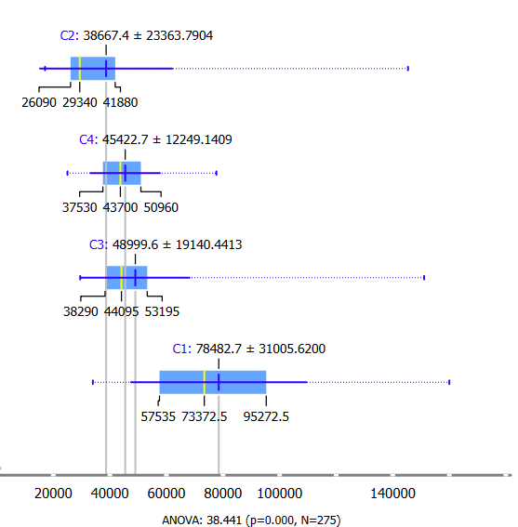
Applied ML – Cluster Definition
Notes:
Add excel formulation snap – tech steps

Slide 18

Profile Formulation

Slide 19




Profile Creation
C1
C2
C3
C4
Luxury Enthusiast
Economical
Commuter
Dynamic Driver
High-End
Motorist
Notes:
It’s estimated that the financial impact of irregularities on the daily operations of a single major U.S. domestic carrier may exceed $440 million per annum in lost revenue, crew overtime pay, and passenger hospitality costs.

Slide 20





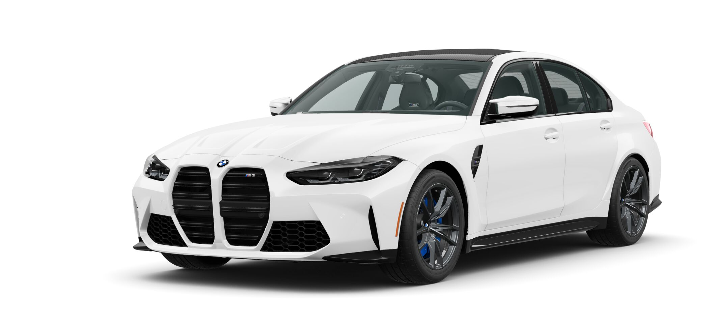
Luxury Enthusiast
Profile Statistics
Vehicle Models
CMPG: 15
HMPG: 22
Price: $73k
Key Words
Porsche Cayenne
Luxury
V8
Turbo
Interior
SUV
Jaguar F-Type
BMW M3
Notes:
It’s estimated that the financial impact of irregularities on the daily operations of a single major U.S. domestic carrier may exceed $440 million per annum in lost revenue, crew overtime pay, and passenger hospitality costs.

Slide 21





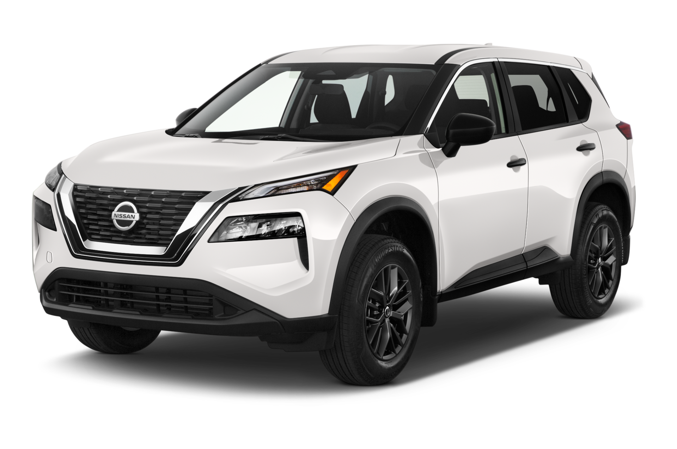
Economical Commuter
Profile Statistics
Vehicle Models
CMPG: 30
HMPG: 37
Price: $29k
Key Words
Honda Civic
MPG
Range
2.0 Liters
Hybrid
Compact
Nissan Rogue
Kia K5
Notes:
It’s estimated that the financial impact of irregularities on the daily operations of a single major U.S. domestic carrier may exceed $440 million per annum in lost revenue, crew overtime pay, and passenger hospitality costs.

Slide 22

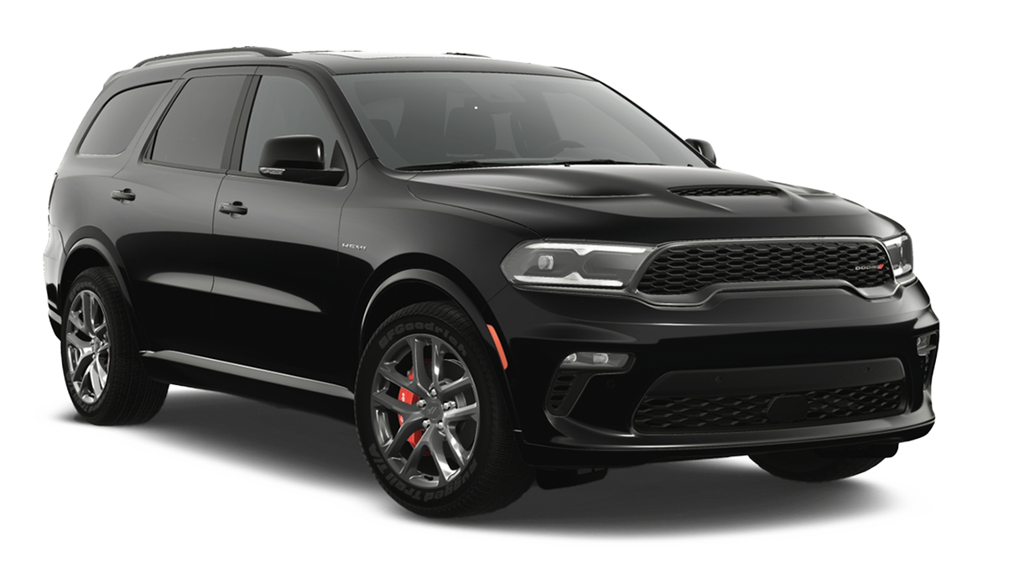


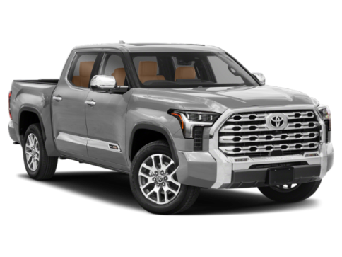

Dynamic Driver
Profile Statistics
Vehicle Models
CMPG: 17
HMPG: 23
Price: $44k
Key Words
Dodge Durango
4wd
3.5 Liter
Cargo
V8
5 Seater
Mazda CX9
Toyota Tundra
Notes:
It’s estimated that the financial impact of irregularities on the daily operations of a single major U.S. domestic carrier may exceed $440 million per annum in lost revenue, crew overtime pay, and passenger hospitality costs.

Slide 23






High-End Motorist
Profile Statistics
Vehicle Models
CMPG: 23
HMPG: 30
Price: $44k
Key Words
Mercedes CLA
Premium
Performance
Luxury
Turbo
AWD
Audi S3
Volvo S60
Notes:
It’s estimated that the financial impact of irregularities on the daily operations of a single major U.S. domestic carrier may exceed $440 million per annum in lost revenue, crew overtime pay, and passenger hospitality costs.

Slide 24

Final Takeaways

Slide 25




Rationale and Findings
Produce Customer Profiles
Clusters are Human Driven
Cars are Grouped by Attributes
Clusters Known to the Car Industry

Slide 26


Success and Hurdles
Successes
K-means clustering
PCA for feature selection
Hurdles
Sentiment analysis
Hierarchical clustering
Original dataset
Notes:
It’s estimated that the financial impact of irregularities on the daily operations of a single major U.S. domestic carrier may exceed $440 million per annum in lost revenue, crew overtime pay, and passenger hospitality costs.

Slide 27




Future Considerations
Connect to Credit Score/Loan Information
Projected monthly payment
Financing options
Compare with similar vehicles at other price points
Web Application
Takes user demographics and feedback into account for future users
Enhanced Dataset
Greater variety of makes and models
Additional features for specific vehicles
Customer reviews
Questionnaire to identify desired features
Select desired specifications
Provide information on intended use
Notes:
It’s estimated that the financial impact of irregularities on the daily operations of a single major U.S. domestic carrier may exceed $440 million per annum in lost revenue, crew overtime pay, and passenger hospitality costs.

Slide 28
Thank you!
Q&A

